Slide 1

Parent Meeting
2026-27 Season

Slide 2
MacArthur Basketball Coaches
Head Coach: Shannon Spencer
  Email: saspencer@aldineisd.org
  Phone Number: 713-775-6032
  Conference: 5th
Assistant Coach: Colby Haevischer (Soph)
  Email: chaevischer@aldineisd.org
  Phone Number: 979-627-5387
  Conference: 5th
Associate Head Coach: Jeff Wylie (JV)
  Email: jwiley@aldineisd.org
  Phone Number: 713-492-3355
  Conference: 2nd
Assistant Coach: Dhe’Ryan Jackson (9B)
  Email: djackson3@aldineisd.org
  Phone Number: 903-3406132
  Conference: 2nd
Assistant Coach: Timmy Ware (9A)
  Email: tware@aldineisd.org
  Phone Number: 214-436-3695
  Conference: 2nd

Slide 3


News & Schedules
www.macarthurhoops.com
GX6S-E657

Slide 4



Social Media
@MacArthur.Hoops
@MacArthurHoops
@BigMacHoops

Slide 5
Important Dates
Freshman Tryouts
October 17th
9-10am @ Mac 9
Soph, JV, & Varsity Tryouts
October 28th
3-4pm @ Big Mac

Slide 6
Player Expectations
Players are to conduct themselves accordingly in the classroom. Any issues in the classroom may result in extra conditioning or missing playing time.
Players are expected to maintain exceptional grades during the basketball season. Any grades that are below expectation (75), may result in extra conditioning.
Players are expected to treat each coach, teammate, and teachers with respect. Anything else will not be tolerated.
Players are evaluated based on their effort, ability, toughness, and ability to be coached. Any player not succeeding in all areas may result in less playing time.

Slide 7
Player Rules
Players must abide to the AISD athletic code.
Players are expected to behave in the classroom. Misconduct will result in disciplinary actions.
Players apparel and appearance should be in line with the AISD Student Handbook standards.
Players must show respect to teammates, coaches, and staff. Anything else will not be tolerated and will have consequences.
Players will travel to and from the game on the bus unless there is an emergency situation.
Players are to take care of basketball equipment and keep up with any equipment issued out. You will pay for lost, stolen, or damaged equipment.

Slide 8
Practice
DO NOT, miss practice unless absolutely necessary.
If a player is absent he must notify their coach before the practice.
Parents can notify in 2 ways:
  Call Coach Spencer @ 713-775-6032
  Email Coach Spencer at saspencer@aldineisd.org
Consequences for an unexcused absence will result in disciplinary actions in practice and could result in non-participation in games.
An excused absence would involve personal illness, an injury, the death of a relative and religious holidays.
Please schedule all appointments outside of practice time.
All players will make up missed practice time before next game, regardless if excused or unexcused, or it may result in reduced playing time.
Repeated offenses will result with the consequence being increased, parent conference, and possible dismissal from team.
Do not be late to practice.
  A player is late if he is not completely dressed and ready to participate at the prescribed start time.

Slide 9
Playing Time
Playing time is NON- NEGOTIBALE.
Playing time is earned at practice. Everyone may not play in the game.
Attitude, effort, and knowledge will be a factor in playing time.

Slide 10
Parent Expectations
Be your child’s biggest fan. Help encourage him and his teammates. Allow your child to play and make mistakes. The coaches will help fix those mistakes but we need help in keeping the player focused and in the game not worried about making another mistake.
Be the example of the sportsmanship you would like your son to play with. It is important as parents and coaches we set the example for the kids.
Allow officials to do their job. We know missed calls will be a constant but yelling may lead to more missed calls.

Slide 11
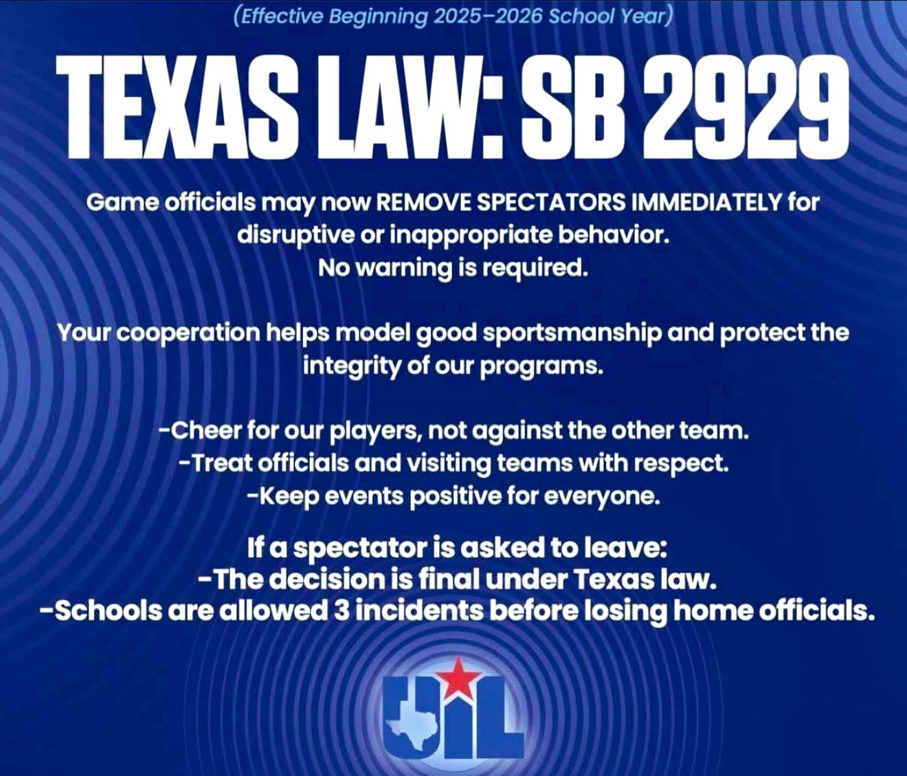
Parent Expectations

Slide 12
Parent Expectations
If you have an issue with coaching or coaching style please refrain from talking to your son about it. I would be more than willing to meet with any parent that has an issue with coaching. During the game I do ask you please allow the coaches to coach.
Any parent that would like to meet with a coach about an issue must wait 24 hours after a game. Coaches will not talk about playing/coaching concerns after a game.
We will only talk to you about your child and not another player.
If your child has any concerns, please direct them to talk to us first. Sometimes we don’t even know there is an issue.

Slide 13
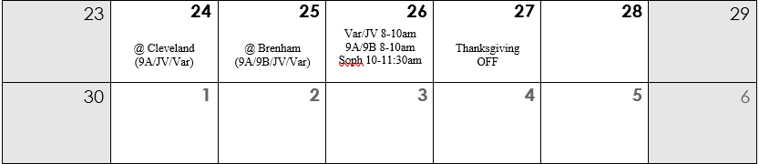
Thanksgiving Holidays

Slide 14
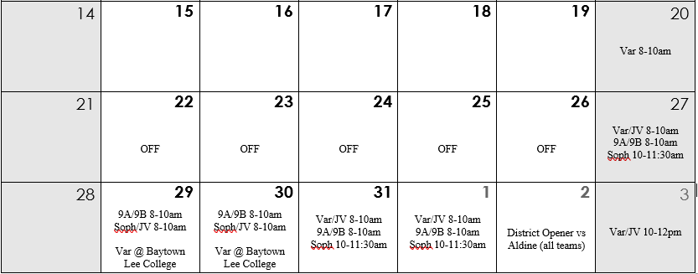
Christmas Holidays

Slide 15
Yearly Expenses
Uniforms- $1,900
Practice Gear- $1,500 Budget- $3,800
Travel Gear- $1,200 Expenses- $9,400
______________________
Balls- $1,500 (15)
Deficit- $5,600
Food- $3,000
Socks- $300
_____________________
Total- $9,400

Slide 16
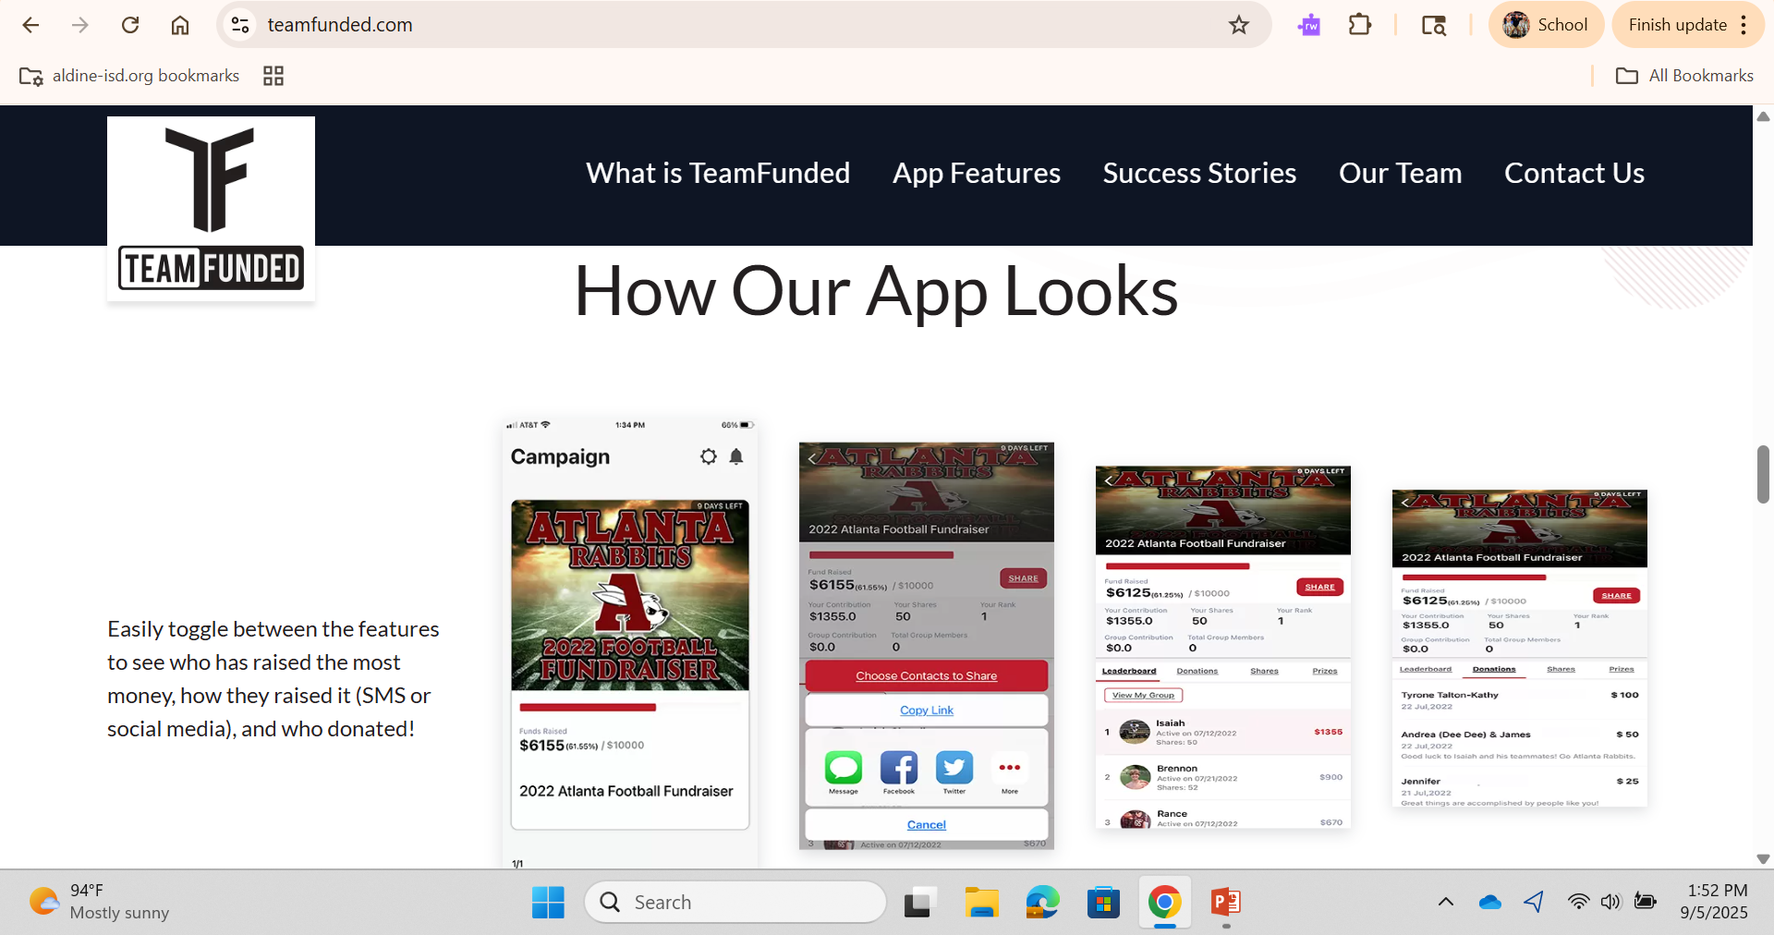
Team Funded

Slide 17

Concessions
https://www.signupgenius.com/go/10C044AAFAA2CA7FEC25-63815098-concession#/

Slide 18
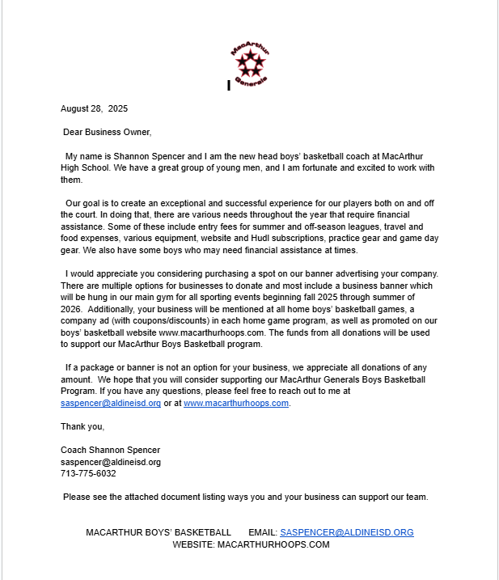
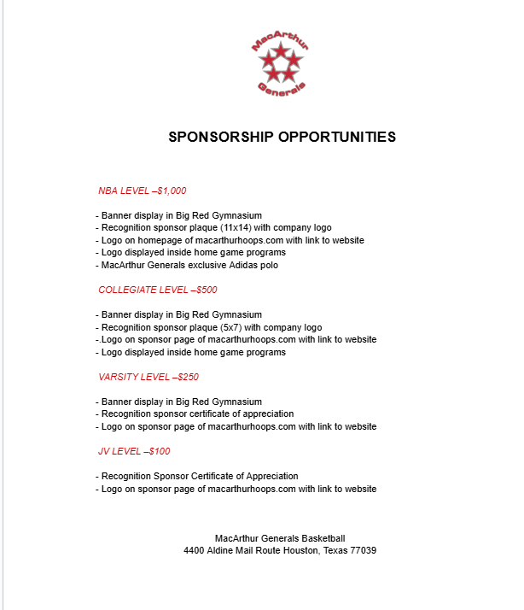
Sponsors

Slide 19
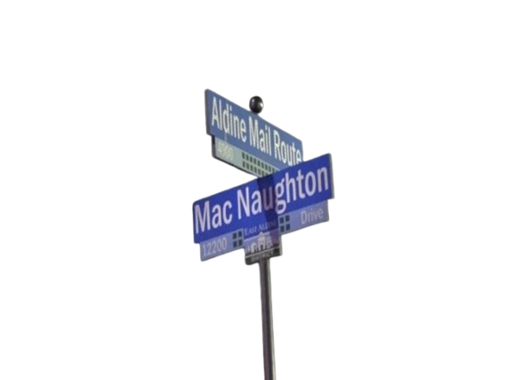
Booster Club
President- Oscar Gonzalez
Vice President-
Treasurer- Chastity Cardozo
Secretary-
Board Member- Jissela Gallegos
There are (2) Board Member positions open.

Slide 20
Year Round Plan
AUG/SEPT: Skill Work/S&C
• Fall league one day per week
• Intense focus on skills and fundamentals training
• Weight training three days per week
• Intro team offensive concepts
• Annual basketball fundraiser
• Practice time 1.5 hours
OCTOBER: Skill work/S&C
• Weight training three days per week
• Begin input of all plays
• Introduction of team defensive concepts
• Individual breakdown workouts with coaches
• Practice time 1.5-2 hours

Slide 21
Year Round Plan
MARCH: UIL State Playoffs
• Weight training 2-3 days per week
• Practice time 1.5 hours
• After season conduct individual player meetings to discuss opportunities for improvement and spring plan
APRIL / MAY: Spring League and Skill Work
• Weight training 3 days per week
• Open gym, 5-on-5 games within the program
• Skill work 2 days per week
• Spring leagues; get younger level many games so they have the opportunity to improve
• Organize “Spring Game” possibly against Alumni or within program
JUNE / JULY: Summer leagues
• Intense focus on skills and fundamentals training
• Weight training 3 days per week
• AAU- Try to play 20-30 games during these two months
• UIL Showcase (Duncanville)

